Slide 1
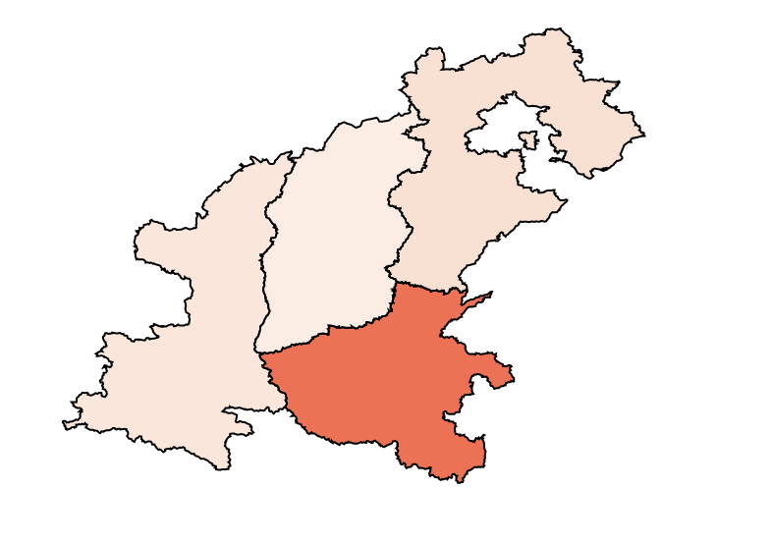


Narrow Range
Full Range

Slide 2
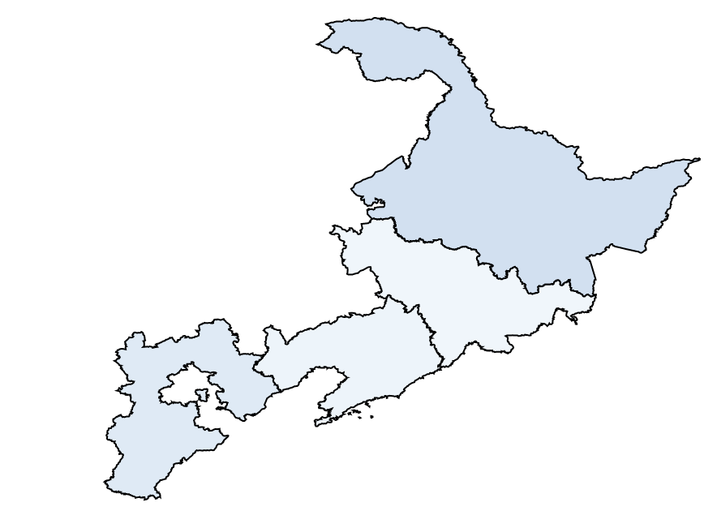


Narrow Range
Full Range

Slide 3
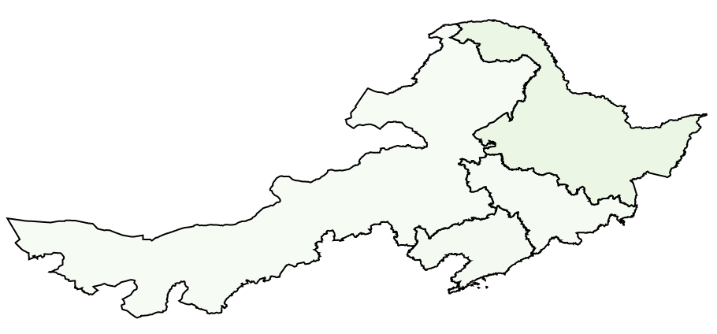


Narrow Range
Full Range

Slide 4
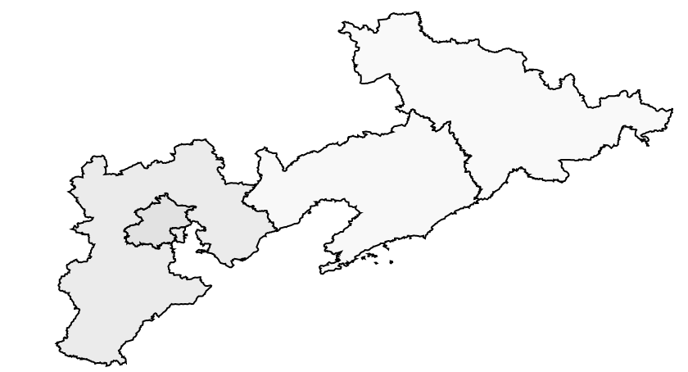


Narrow Range
Full Range

Slide 5
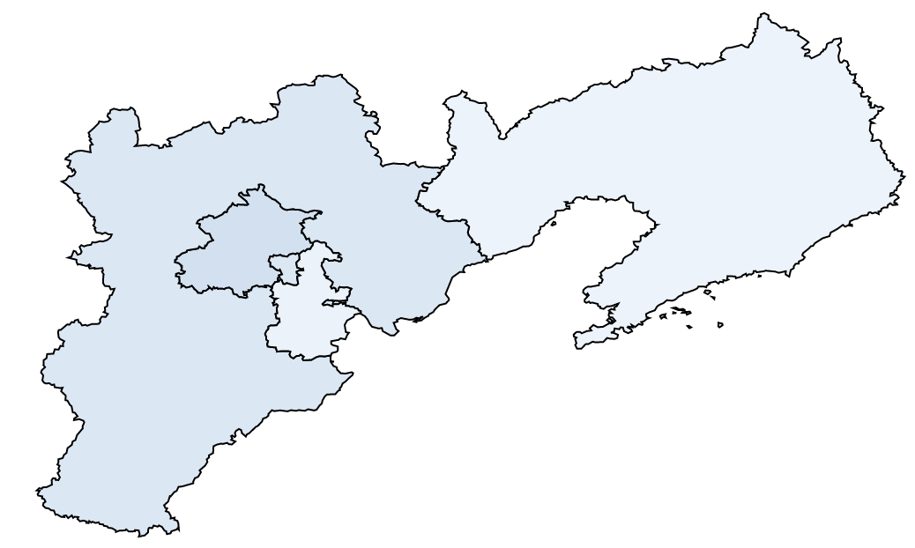


Narrow Range
Full Range

Slide 6
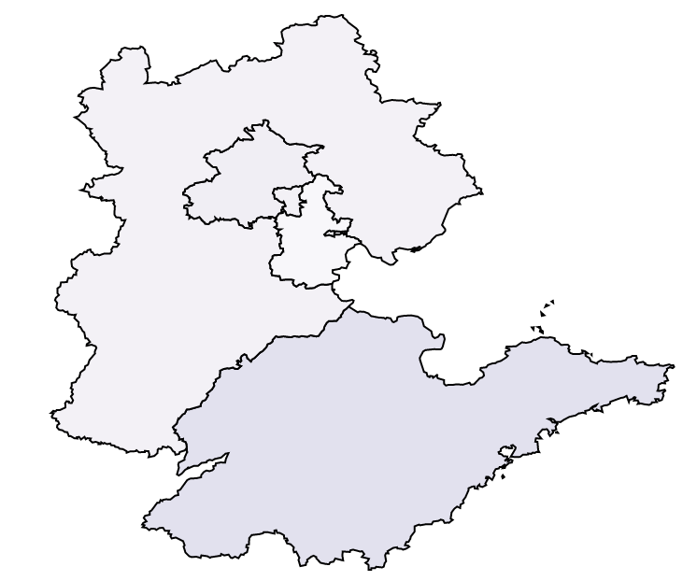


Narrow Range
Full Range

Slide 7
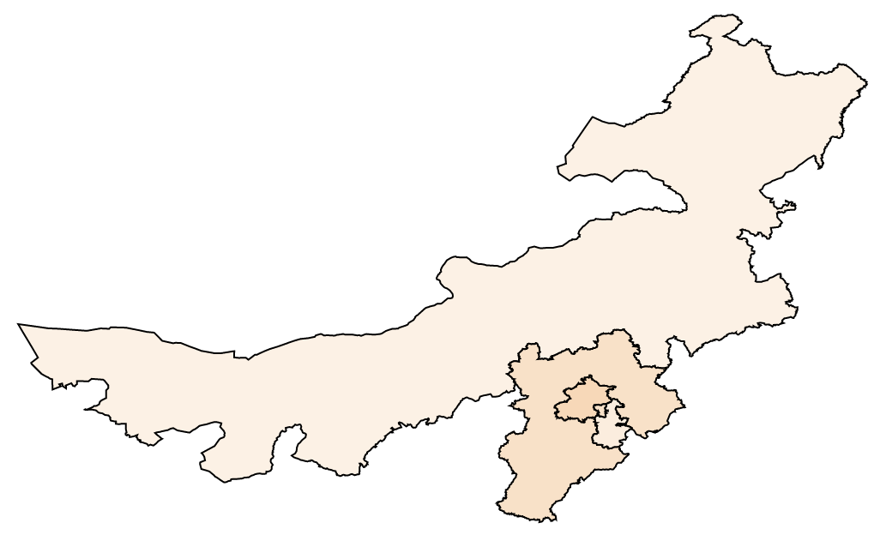
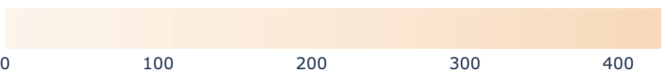

Narrow Range
Full Range

Slide 8
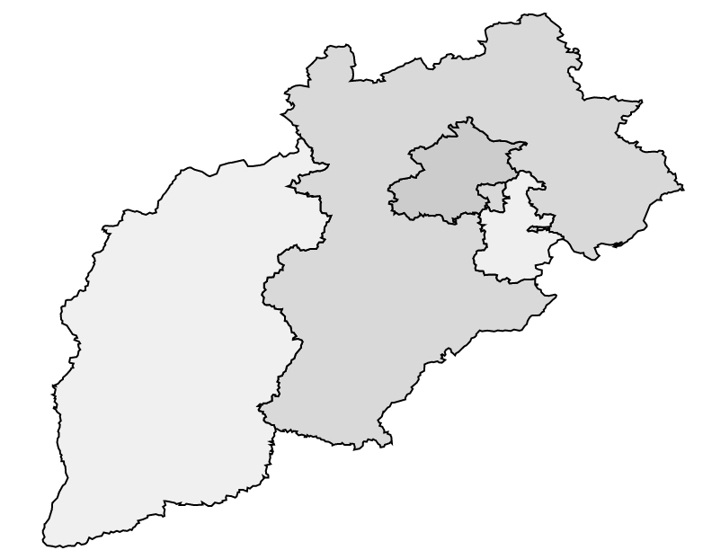


Narrow Range
Full Range

Slide 9
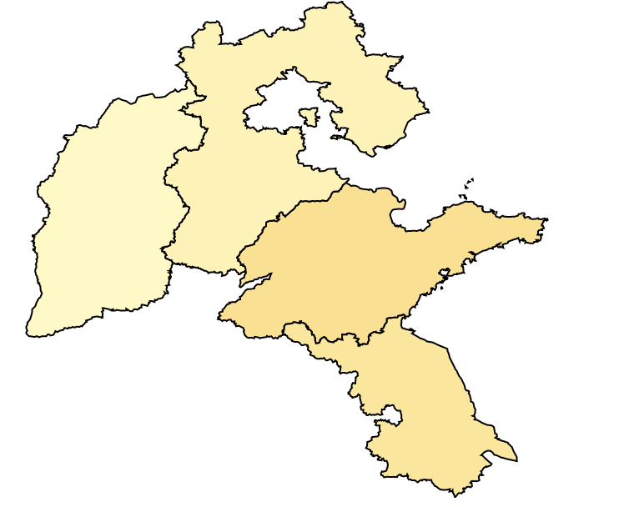


Narrow Range
Full Range

Slide 10
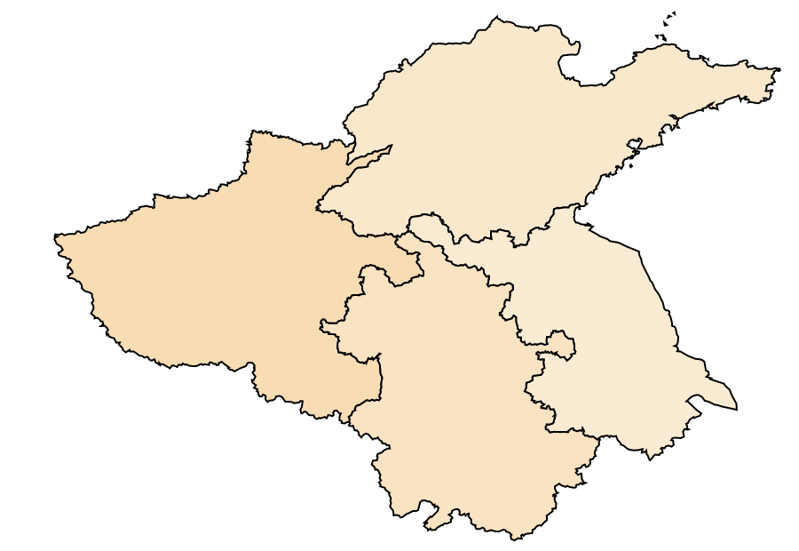


Narrow Range
Full Range

Slide 11
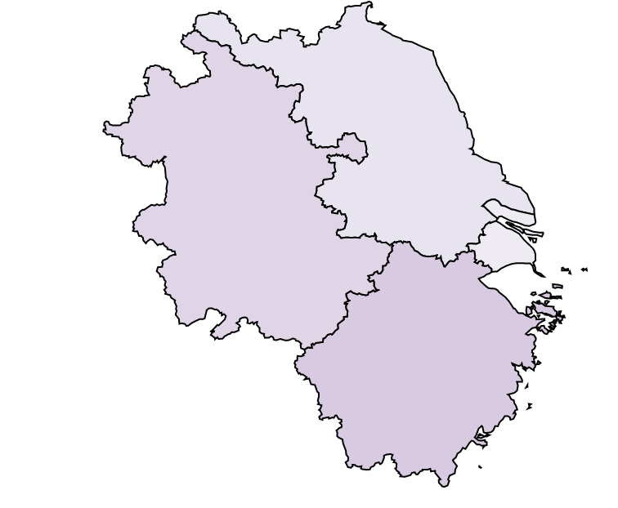


Narrow Range
Full Range

Slide 12
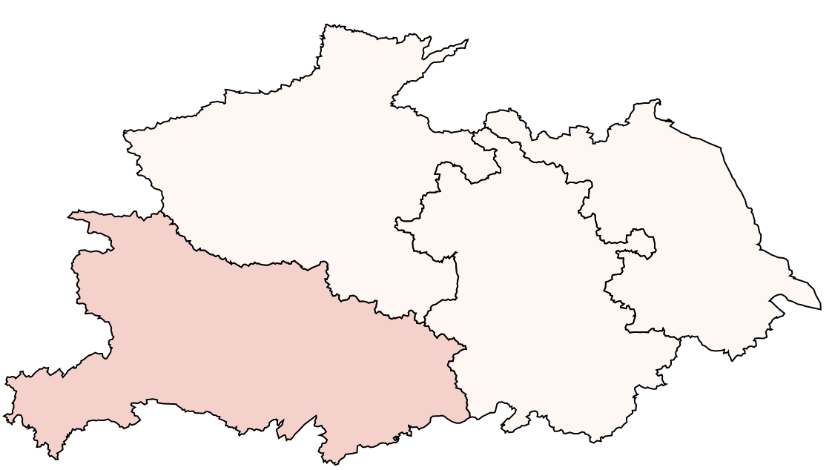


Narrow Range
Full Range

Slide 13
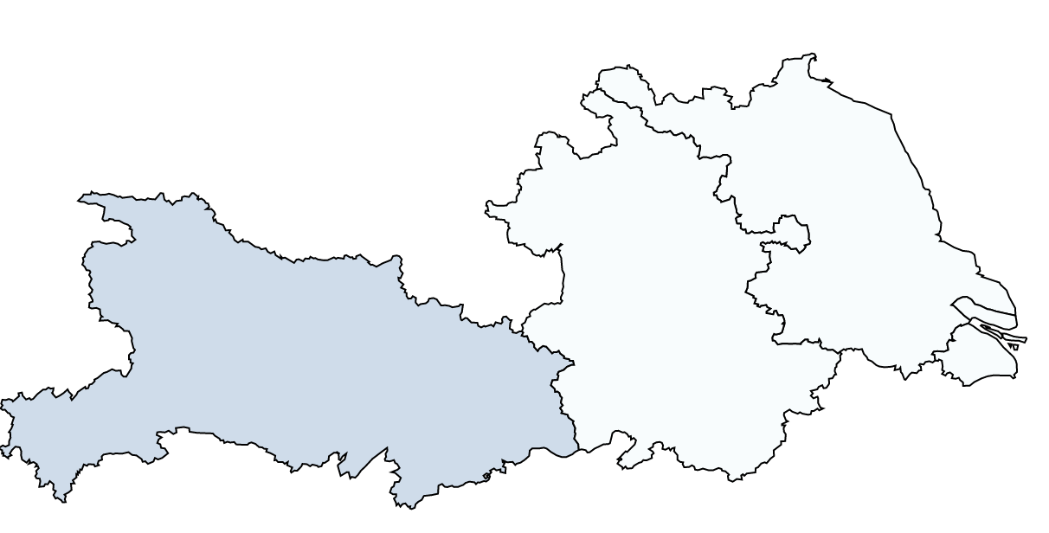


Narrow Range
Full Range

Slide 14
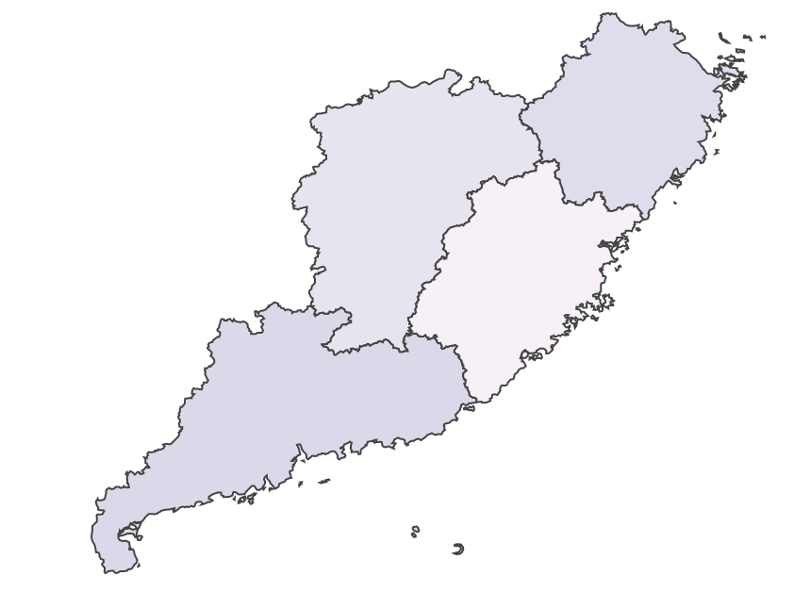


Narrow Range
Full Range

Slide 15
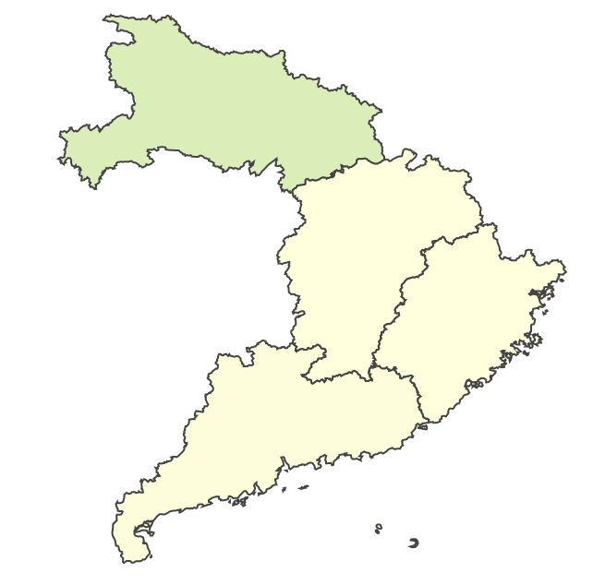


Narrow Range
Full Range

Slide 16
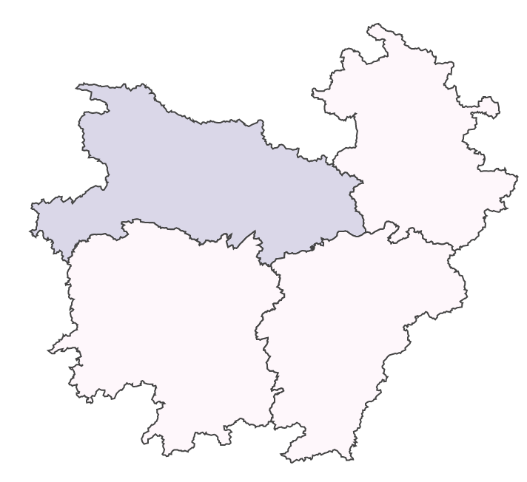


Narrow Range
Full Range

Slide 17
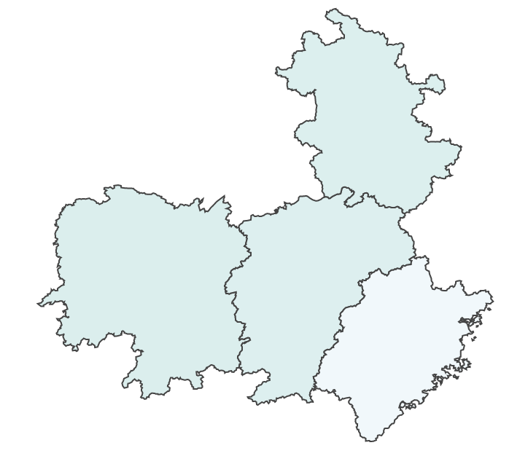


Narrow Range
Full Range

Slide 18
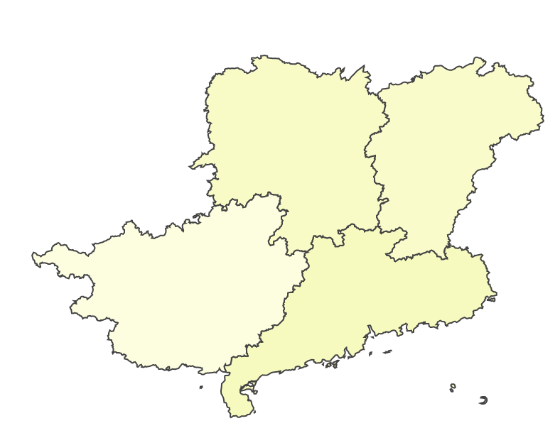


Narrow Range
Full Range

Slide 19
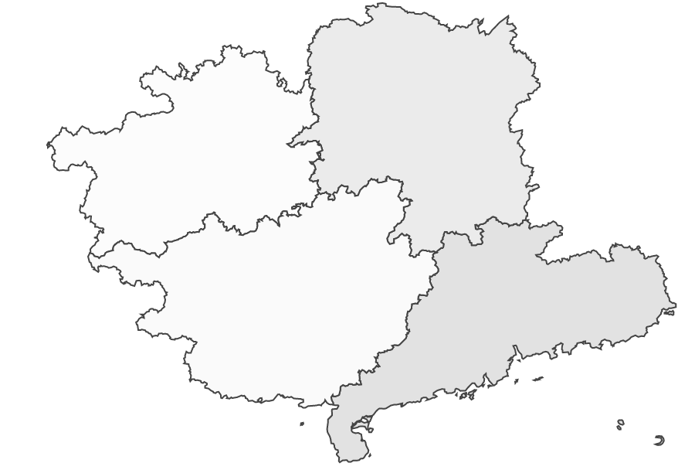


Narrow Range
Full Range

Slide 20
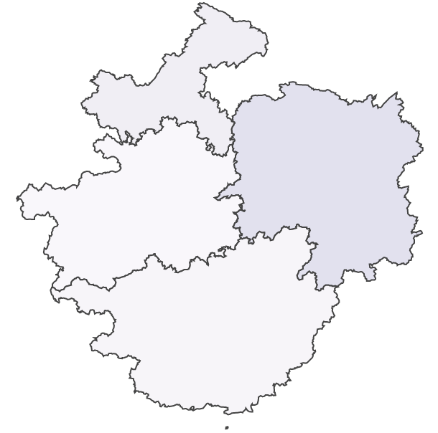


Narrow Range
Full Range

Slide 21
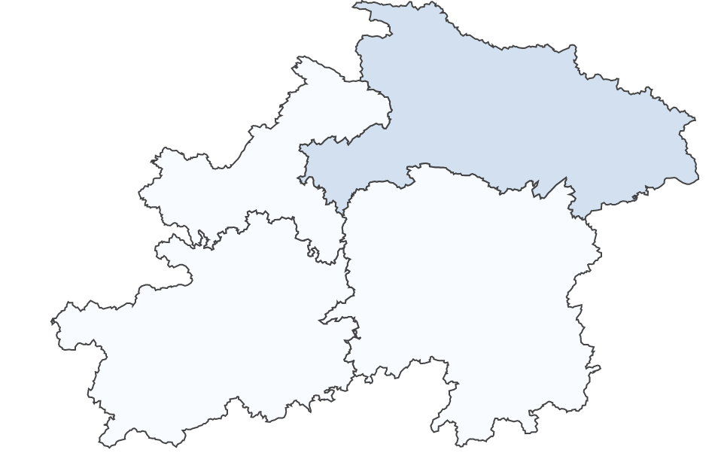


Narrow Range
Full Range

Slide 22
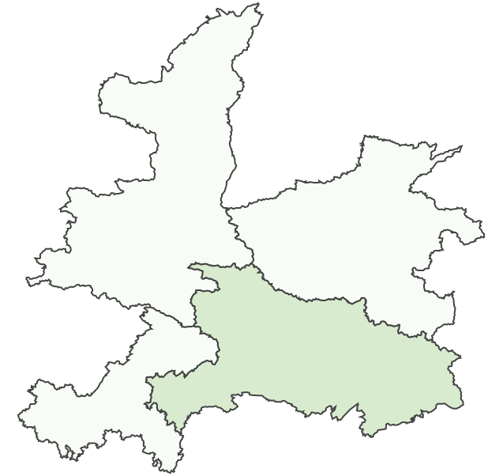


Narrow Range
Full Range

Slide 23
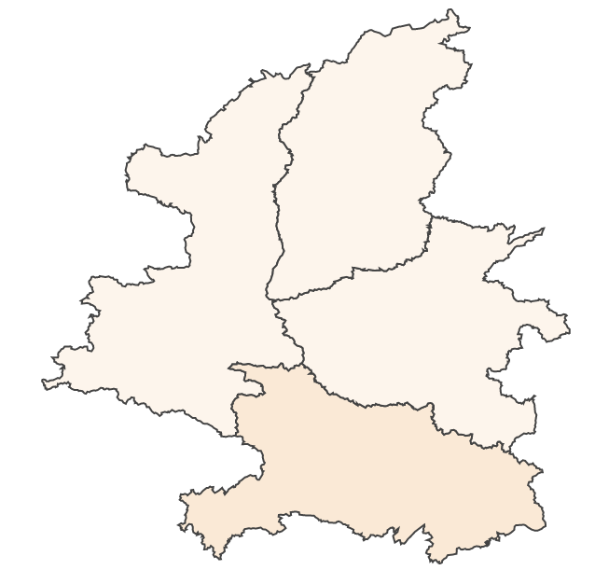


Narrow Range
Full Range

Slide 24
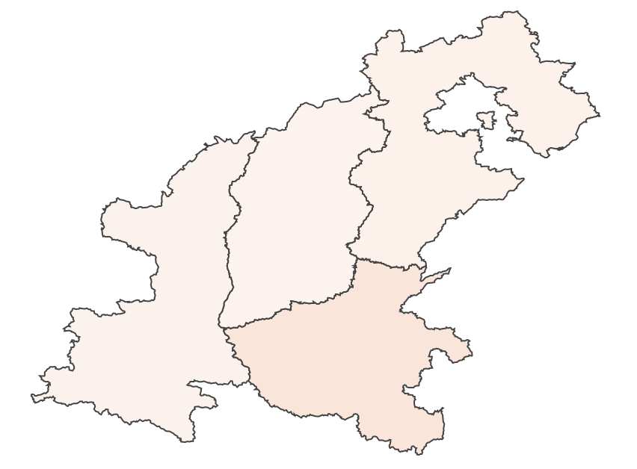
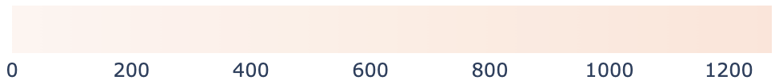

Narrow Range
Full Range

Slide 25
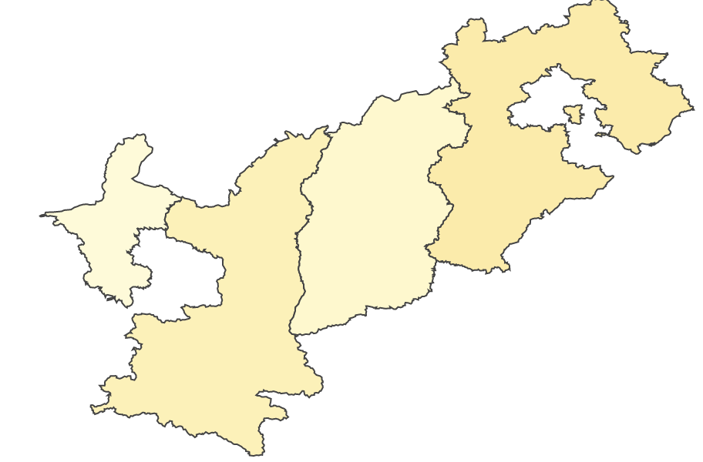


Narrow Range
Full Range

Slide 26
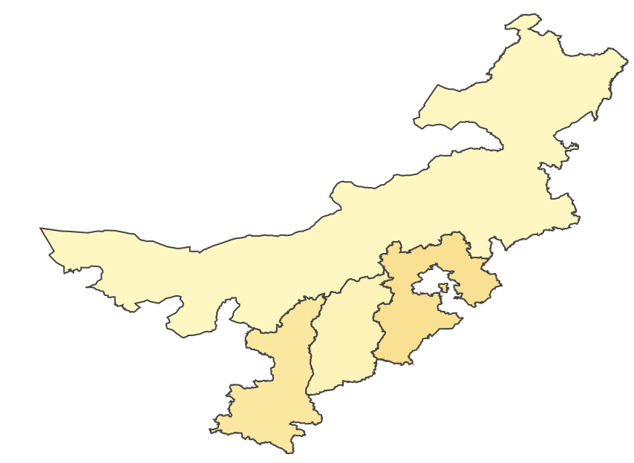


Narrow Range
Full Range

Slide 27
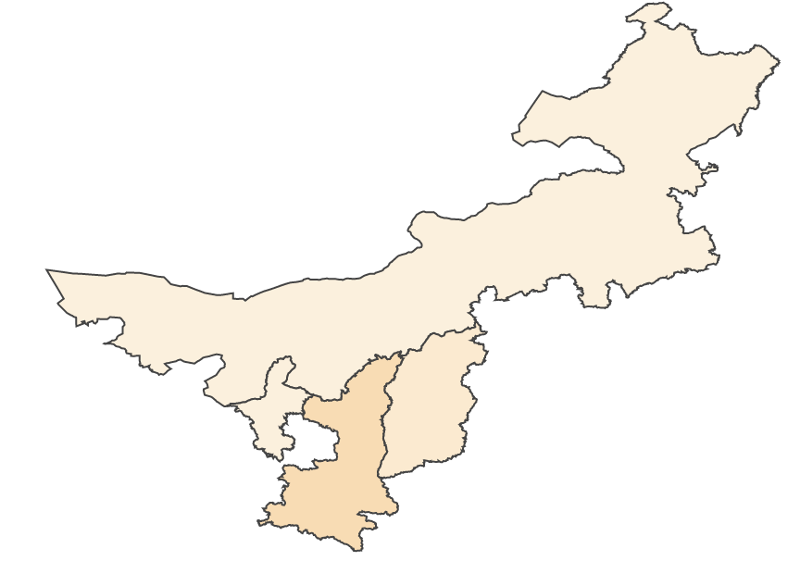

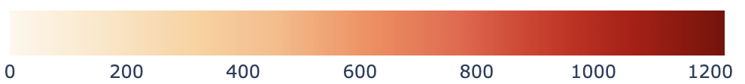
Narrow Range
Full Range

Slide 28
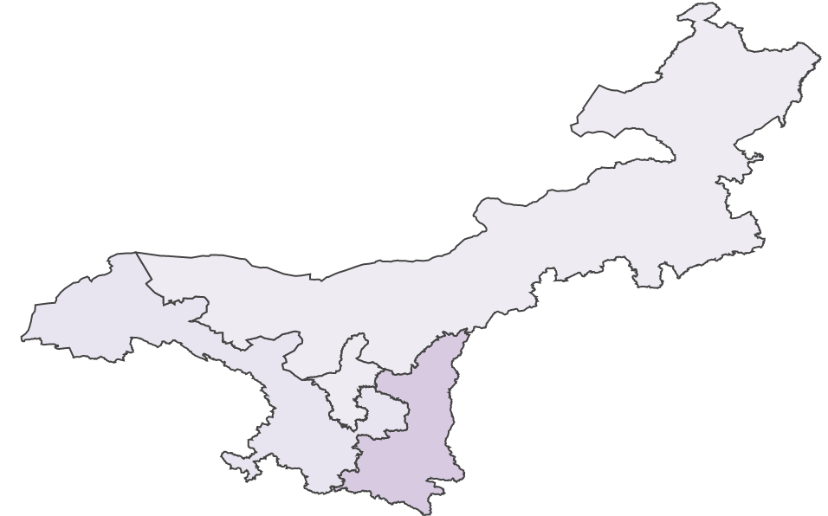


Narrow Range
Full Range

Slide 29
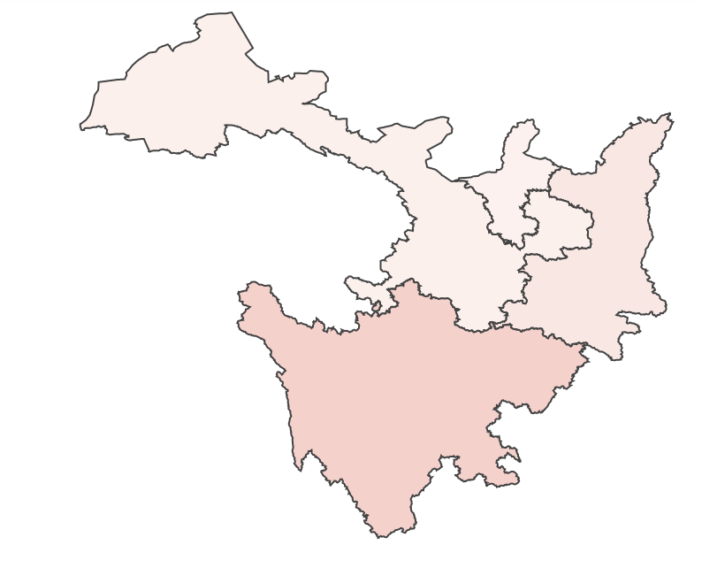
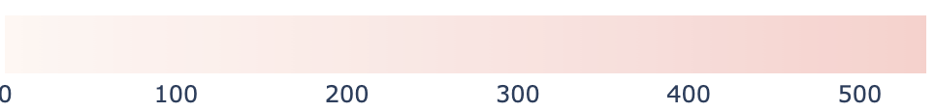

Narrow Range
Full Range

Slide 30
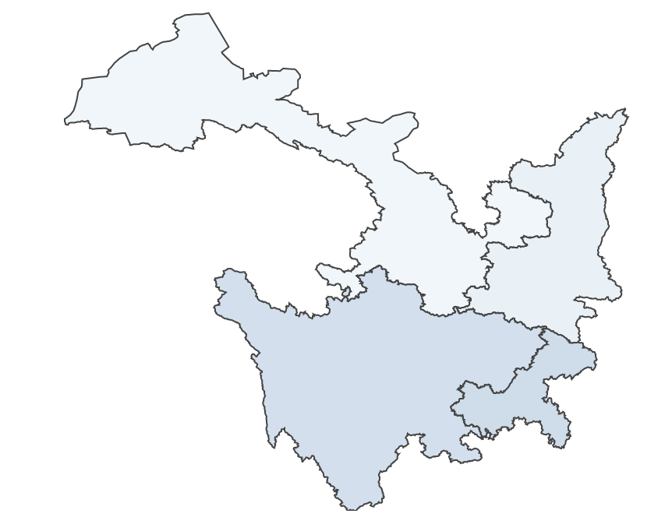


Narrow Range
Full Range

Slide 31
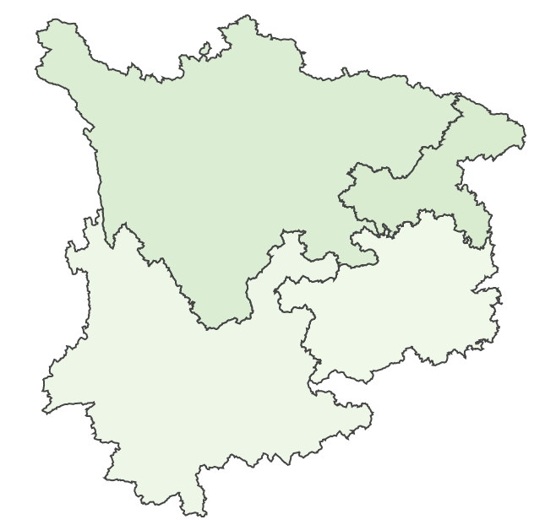


Narrow Range
Full Range

Slide 32
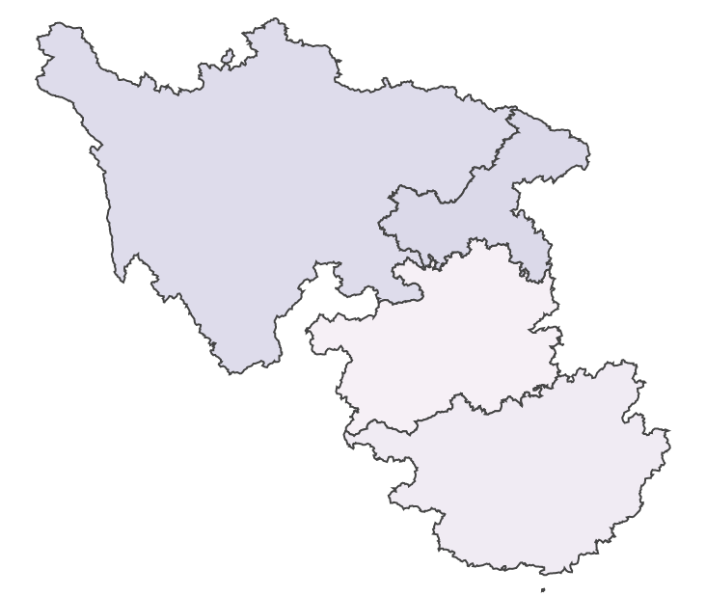


Narrow Range
Full Range

Slide 33
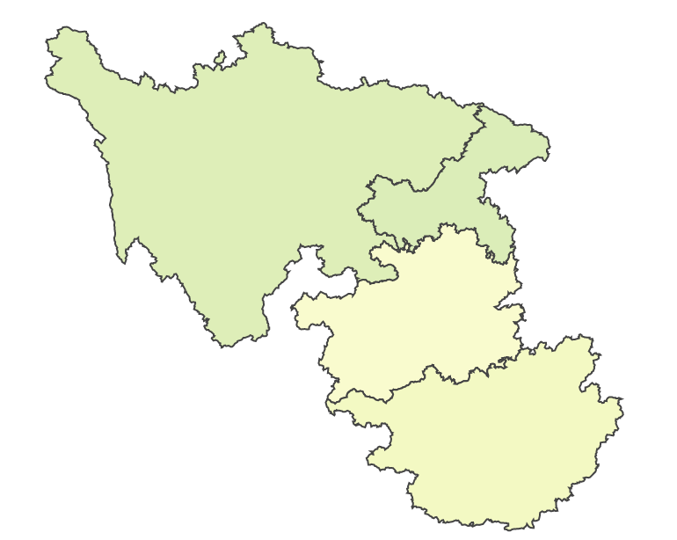


Narrow Range
Full Range

Slide 34
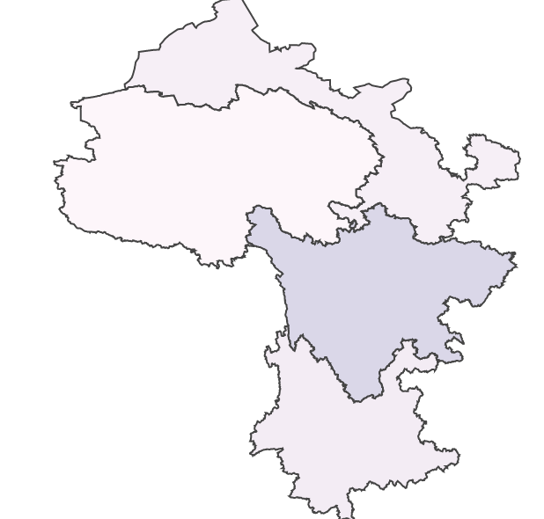

Narrow Range
Full Range

Slide 35
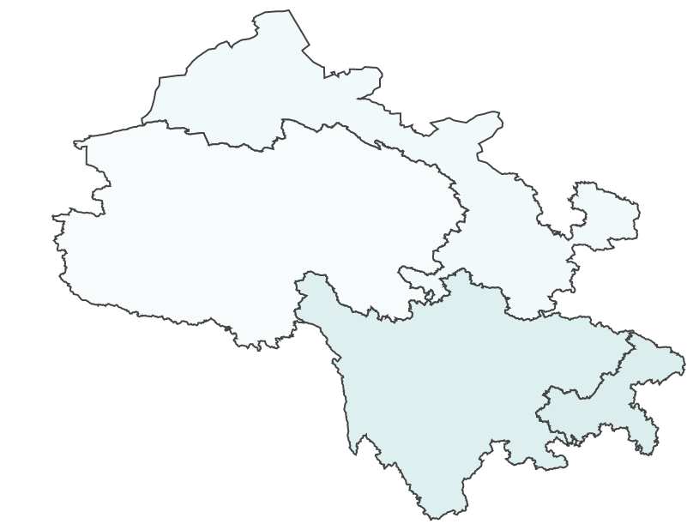


Narrow Range
Full Range

Slide 36
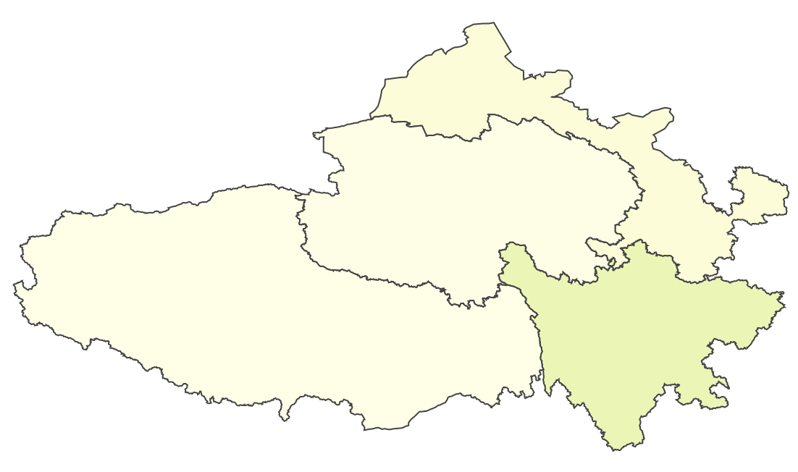

Narrow Range
Full Range

Slide 37
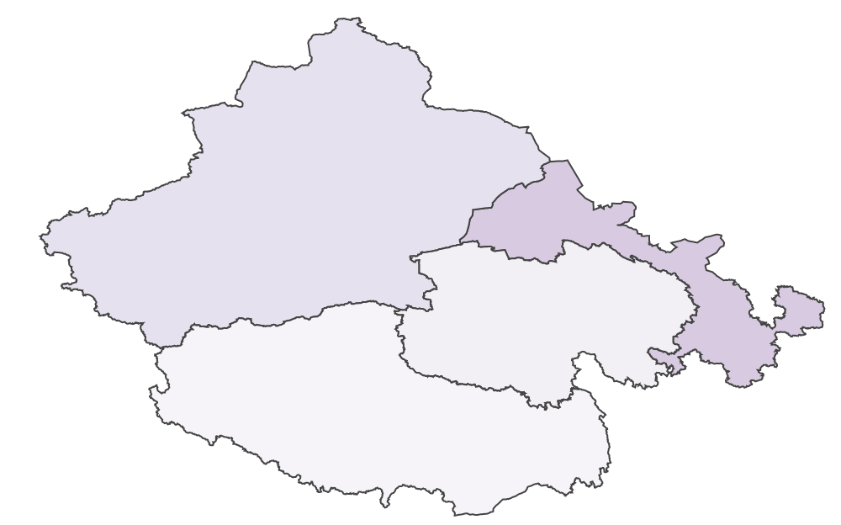


Narrow Range
Full Range

Slide 38
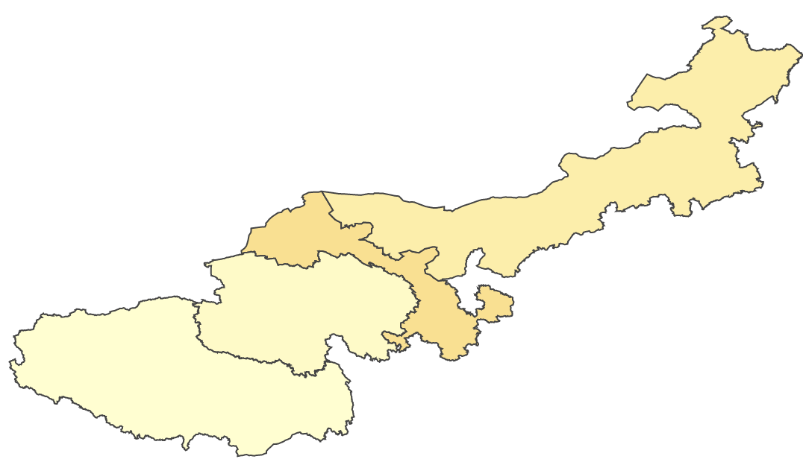


Narrow Range
Full Range

Slide 39
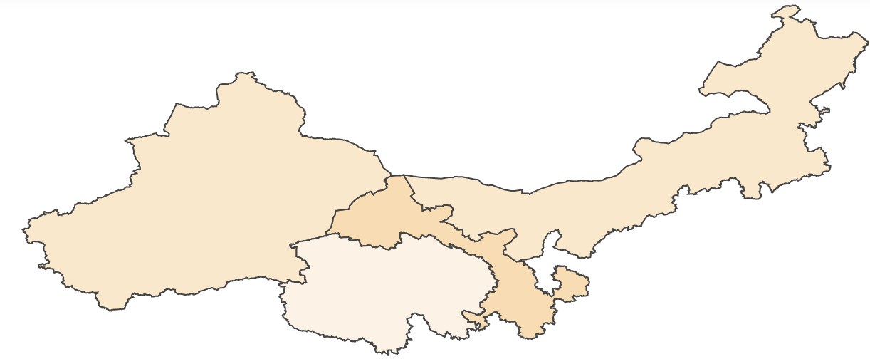
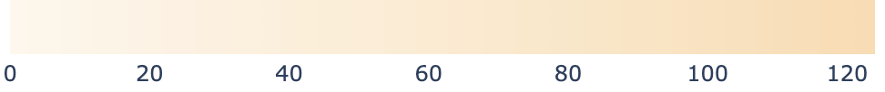

Narrow Range
Full Range

Slide 40
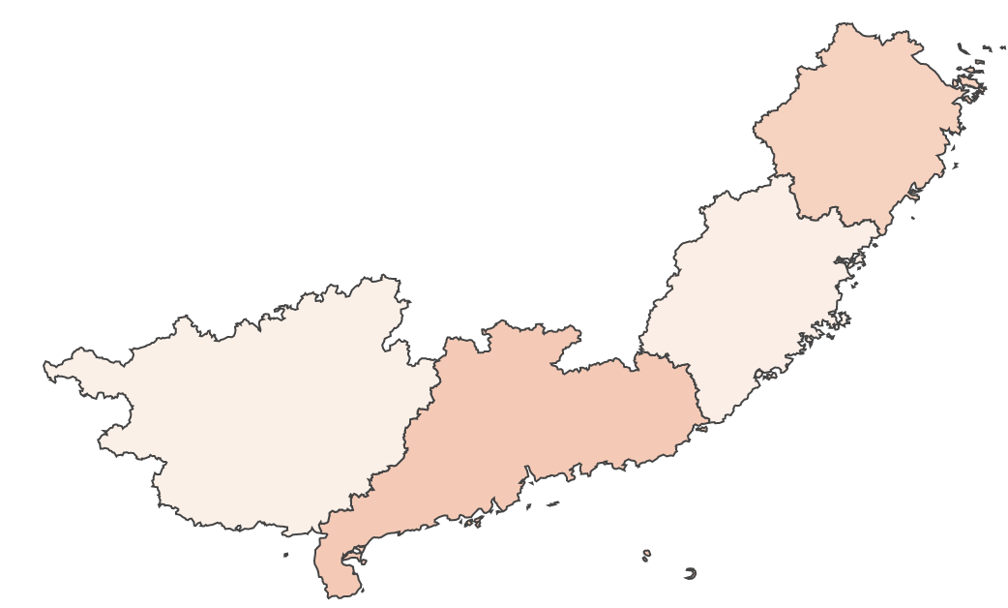


Narrow Range
Full Range

